Slide 1









Whiteboardmaths.com
7
2
1
5
© 2004 All rights reserved

Slide 2

The Surface Area of a Sphere
The formula for the surface area of a sphere was discovered by Archimedes. In the diagram below a cylinder just encloses a sphere of radius r. Archimedes was able to determine the formula by showing that a pair of parallel planes perpendicular to the vertical axis of the cylinder, would enclose equal areas on both shapes.
2πr
Surface area = 2πr x 2r
Surface area = 4πr²
2r
r

2πr

Slide 3
Archimedes did not have the advantage of a sophisticated algebra like we use today. He had to express relationships in terms of simpler geometric shapes. For him the surface area of a sphere was equal to the area of 4 of the greatest circles that it could contain.
Painting the surface of a sphere uses the same amount of paint as painting four of its greatest circles!
Archimedes was intrigued by this amazing discovery. Why is the answer exactly 4 and not 4.342?
πr²
πr²
πr²
πr²
Surface Area
4πr²

Slide 4

Example Questions: Calculate the surface area of the spheres below. (to 1 dp)
SA = 4πr²
1
2
7.3 cm
12 cm
SA = 4πr²
SA = 4πr²
SA = 4 x π x 7.3² = 669.7cm²
SA = 4 x π x 12² = 1809.6 cm²

Slide 5
Questions: Calculate the surface area of the spheres below. (to 1 dp)
SA = 4πr²
1
2
3.2 m
2.4 m
SA = 4πr²
SA = 4πr²
SA = 4 x π x 3.2² = 128.7 m²
SA = 4 x π x 2.4² = 72.4 m²

Slide 6
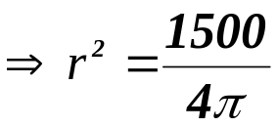

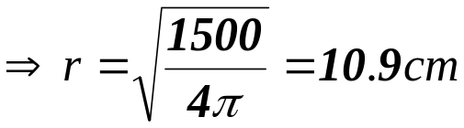
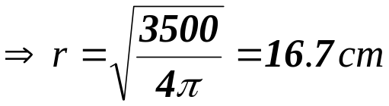
Example Questions: Calculate the radii of the spheres shown below. (to 1 dp)
SA = 4πr²
1
2
SA = 1500 cm²
SA = 3500 cm²
4πr² = 1500
4πr² = 3500

Slide 7
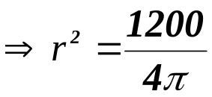
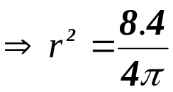
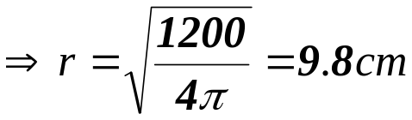
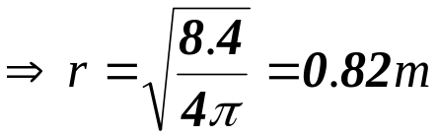
Questions: Calculate the radii of the spheres shown below. (to 1 dp)
SA = 4πr²
1
2
SA = 8.4 m²
SA = 1200 cm²
4πr² = 1200
4πr² = 8.4

Slide 8
Worksheet 1
Example Questions: Calculate the surface area of the spheres below. (to 1 dp)
SA = 4πr²
1
2
7.3 cm
12 cm

Slide 9
Worksheet 2
Questions: Calculate the surface area of the spheres below. (to 1 dp)
SA = 4πr²
1
2
3.2 m
2.4 m

Slide 10
Worksheet 3
Example Questions: Calculate the radii of the spheres shown below. (to 1 dp)
SA = 4πr²
1
2
SA = 1500 cm²
SA = 3500 cm²

Slide 11
Worksheet 4
Questions: Calculate the radii of the spheres shown below. (to 1 dp)
SA = 4πr²
1
2
SA = 8.4 m²
SA = 1200 cm²

